Slide 1
HTML, CSS & JavaScript

Slide 2
Learn Frontend Technologies
Objective
Video Material
Learn HTML5
Learn JavaScript
Learn CSS3
Learn Bootstrap framework
HTML Fundamentals 2h
JavaScript: Getting Started (Till Video #37) 4.5h
Introduction to CSS 6h
Bootstrap: Getting Started 4.5h
Study Material
https://www.w3schools.com/html/default.asp
https://www.w3schools.com/css/default.asp
https://www.w3schools.com/js/default.asp

Slide 3
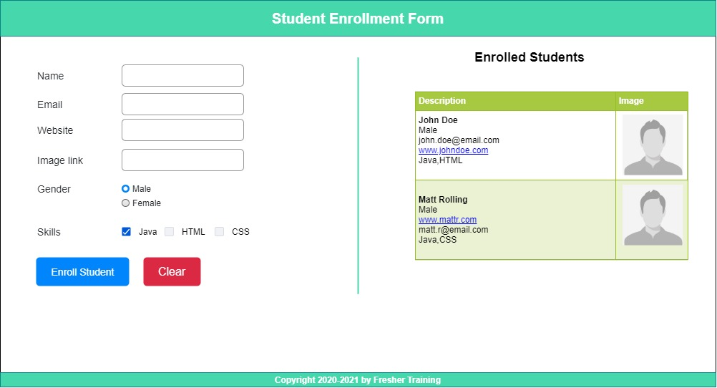
Assignment
Create a student enrollment form

Slide 4
Expected Behavior and Output
The enrollment page should be created using HTML5, CSS3 and Javascript.
All fields of the form should have necessary validations and error messages on validation failure.
On form submission the enrolled student should be added dynamically to the table using JavaScript.
The image should be loaded from the URL submitted in the form and website link should open in a new tab on clicking
The new enrollment should be added with a fade-in effect achieved using CSS animations.
The webpage should be responsive for all resolutions and screen-sizes.
Bootstrap framework should be used for layout and forms.
UI should match as shown in the mockup

Slide 5
Evaluation Criteria
Code completeness and correctness
Use of HTML5 features/semantic tags
Usage of CSS3 styling and animations
Javascript usage
Code quality (Variable names/separate style and script files)
Responsiveness
Usage of Bootstrap framework

